Slide 1
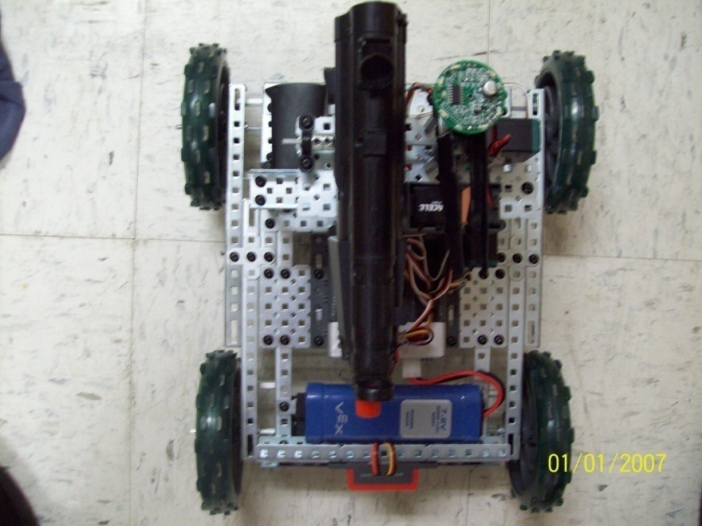
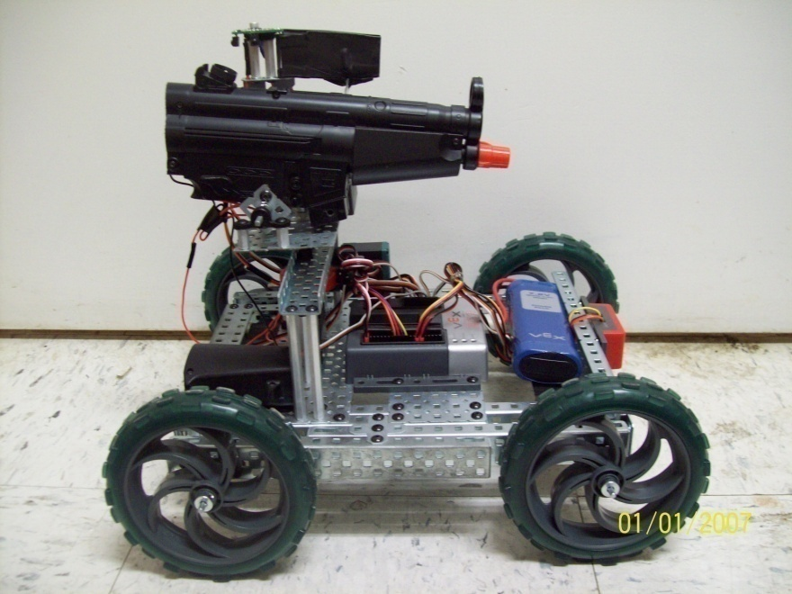
A.R.E.S.
Autonomous Robotic Engagement Sentry
Presented by Nick Handelman
Millsaps College Department of Computer Science
Fall 2010 - Spring 2011

Slide 2
History of Robotics
“any machine or mechanical device that operates automatically with humanlike skill” – or on remote command of a human
Aristotle (c. 320 BCE): “If every tool, when ordered, or even of its own accord, could do the work that befits it... then there would be no need either of apprentices for the master workers or of slaves for the lords.”
1921 - First used by Karel Capek from the Czech word “robota” meaning servitude
1942 - Asimov’s Three Laws of Robotics and the Zeroth Law
1961 - Engelberger, Devol and Unimate

Slide 3
The Big “Why”
Why use robots for military operations?
Most importantly, soldiers are removed from physical danger
Also consider basic human physical needs and the psychological impact of war
Machines are generally more precise and efficient than humans at mathematical and mechanical operations

Slide 4
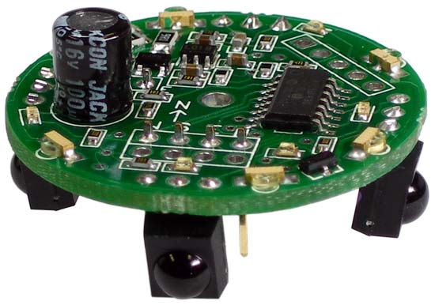
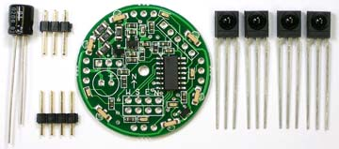
Infrared Sensor Details
Pieces soldered to the main board
Four directional sensors
Six infrared emitters

Slide 5
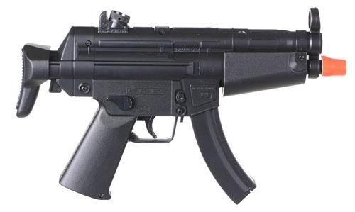
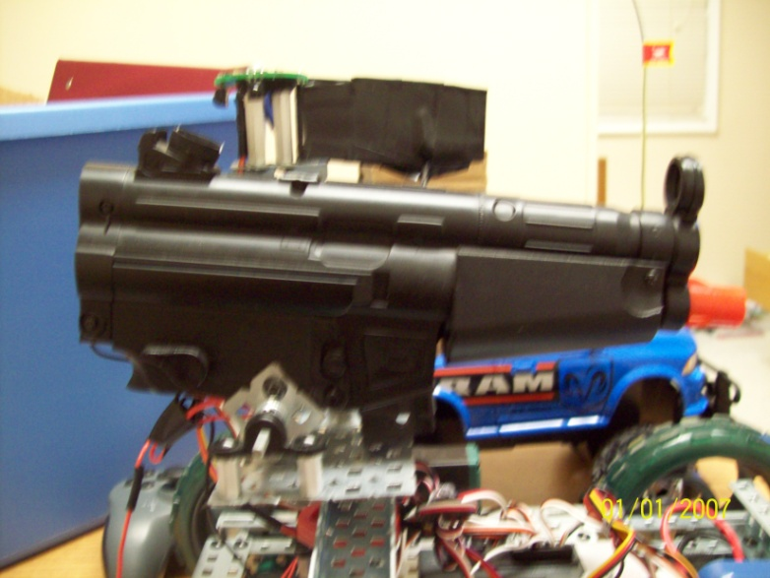
Airsoft Gun Modification
Determine how the gun works
Analyze the best way to combine the gun and drive platform

Slide 6
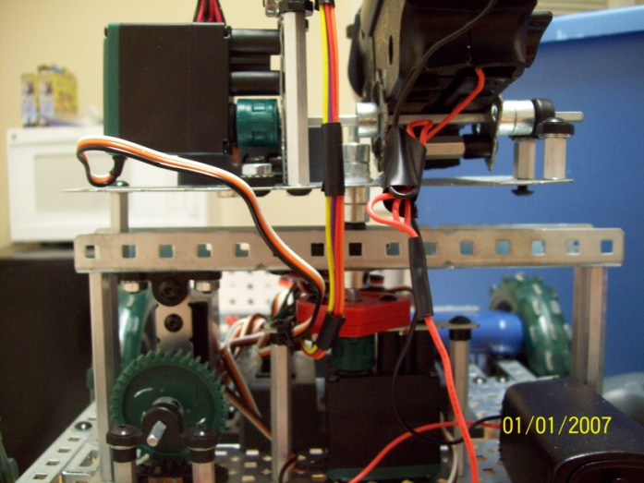
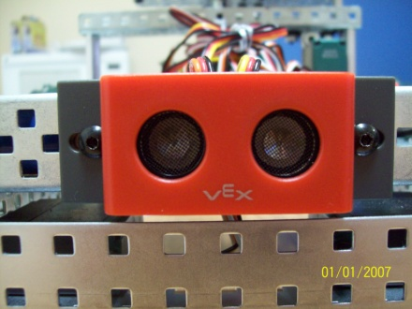
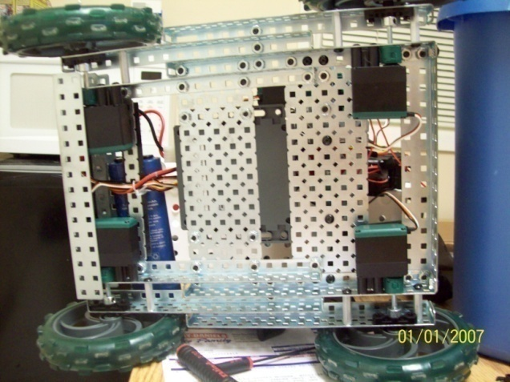
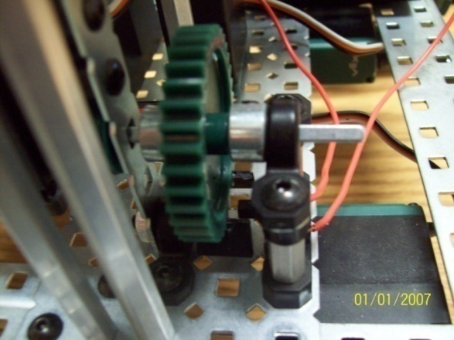
A.R.E.S. Technical Features
Ultrasound Obstacle Detection
Rotation and Panning
Four-Wheel Drive
Firing Mechanism

Slide 7
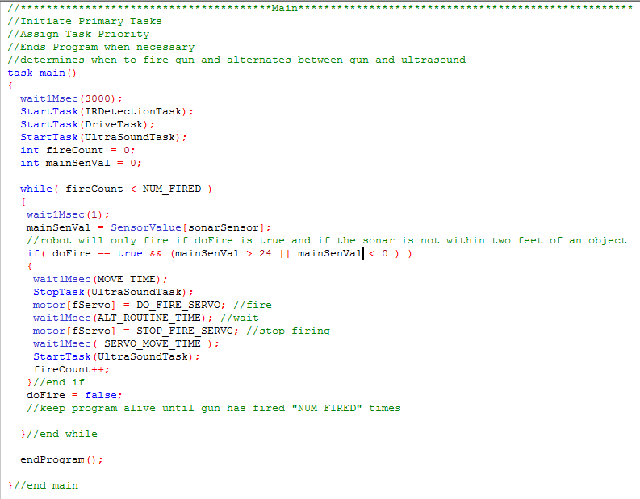
RobotC Code Example: task main()
Mobile Mode

Slide 8
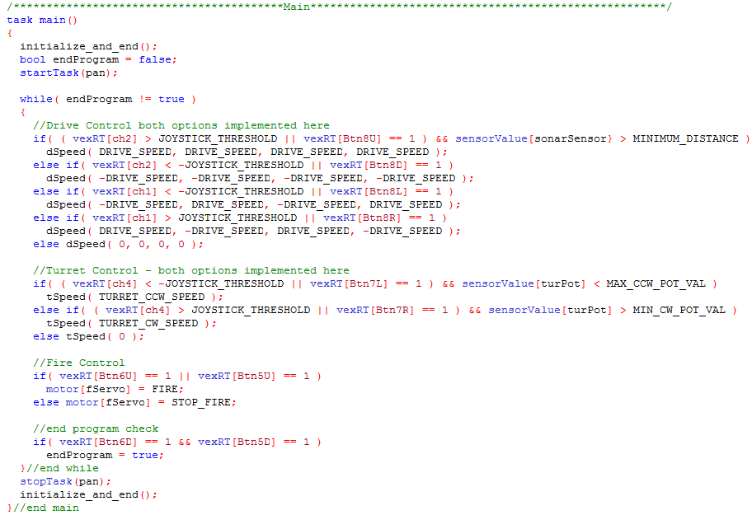
RobotC Code Example: task main()
Remote Controlled Mode

Slide 9

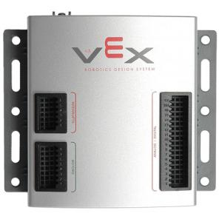
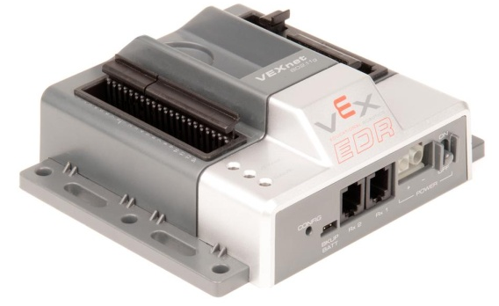

Technology Comparison
 | PIC V0.5 | ARM Cortex M-3 | IPhone 4 | Inspiron 15 Laptop
RAM | 1.8 KB | 64 KB | 512 MB | 2-4 GB
Hard Disk / Flash (SSD) | 32 KB (Flash) | 384 KB (Flash) | 16/32 GB (Flash) | 500 GB (Hard Disk)
Speed | 40 MHz | 100 MHz | 1 GHz | 2.2 GHz
MIPS | 10 | 90 | 2000 | 29142

Slide 10
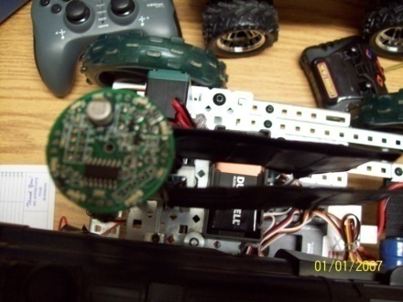



Major Project Conflicts
Getting parts from different companies to work together
Gun and ultrasound
Infrared sensor field of detection

Slide 11
A.R.E.S. in Action
Mobile Mode

Slide 12
A.R.E.S. in Action
Stationary Mode

Slide 13
Future of Military Robotics
As early as 2025, autonomous robots in the field will become the norm
Tactical Autonomous Combatants (TAC) will work in various environments under various conditions and have various forms
Robots will be more capable than humans and without our physical limitations
Specific jobs will include: search, rescue, inspection, maintenance, transport, hazardous material disposal and ultimately soldier, sailor and pilot

Slide 14


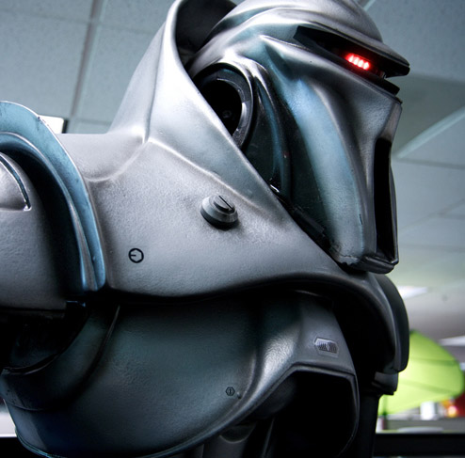

These robots
NOT these robots

Slide 15
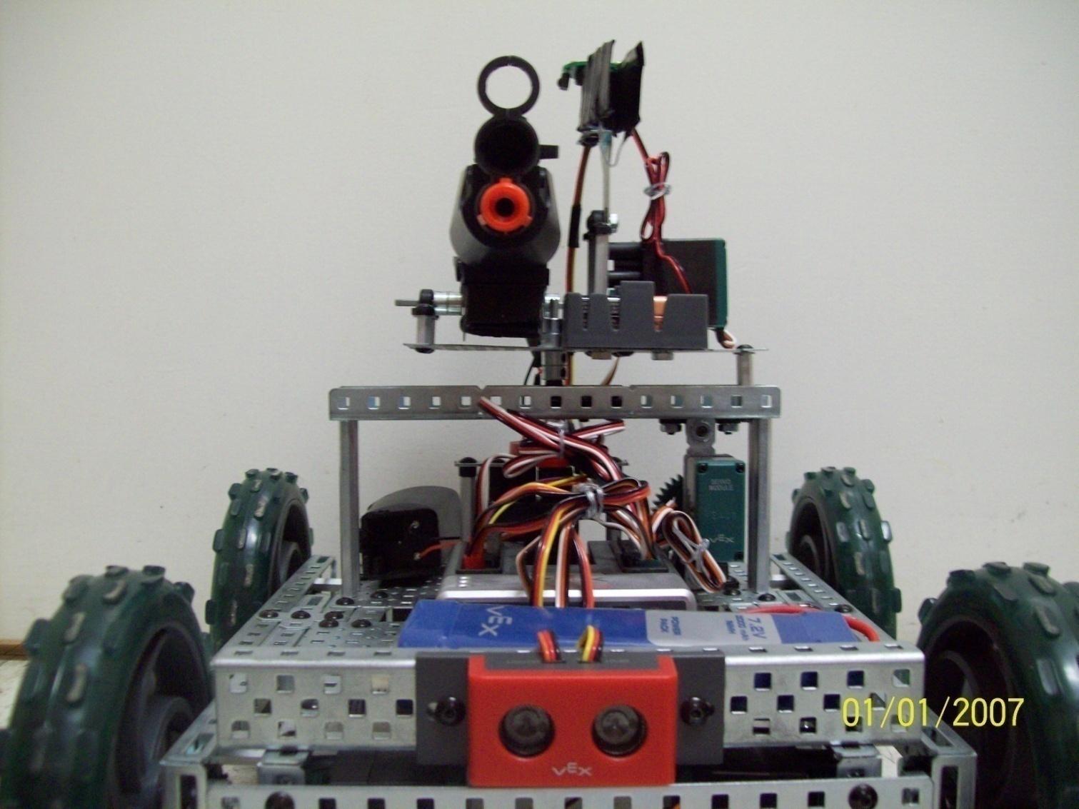
Questions or Comments?

